Slide 1
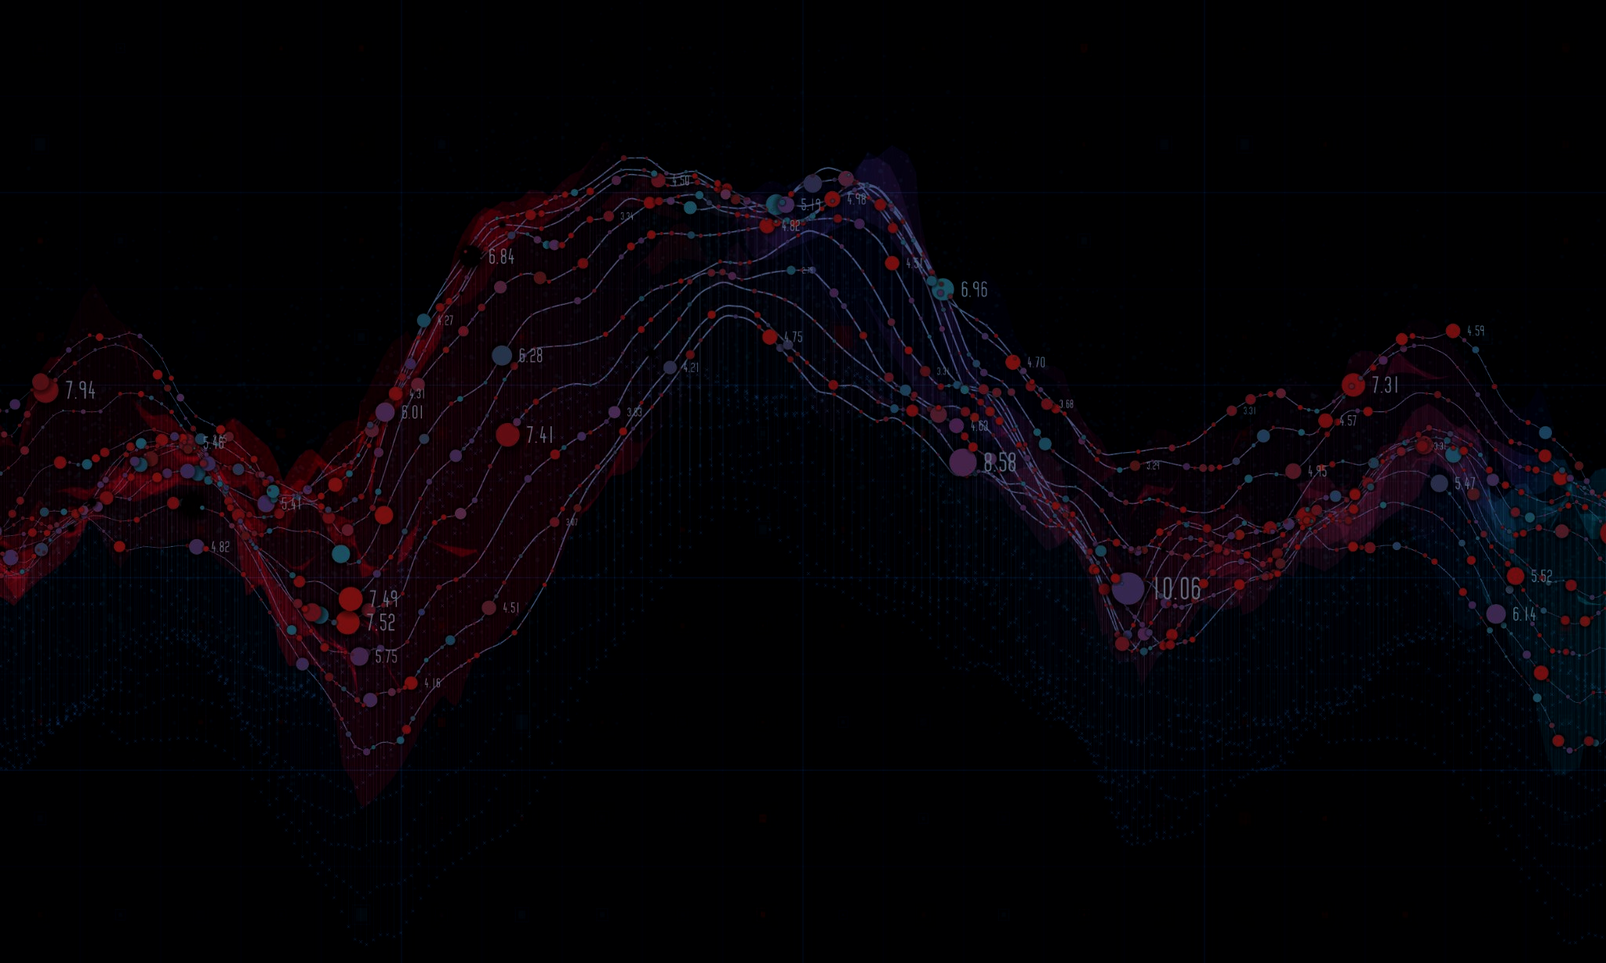
Introduction to Scientific Computing
Emmanuel Gonzalez, Ariyan Zarei, Chosen Obih, Travis Simmons, and Nathan Hendler

Slide 2

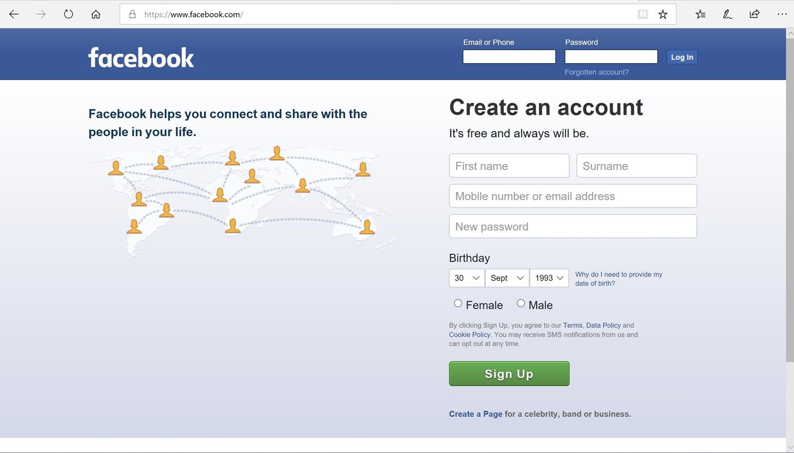
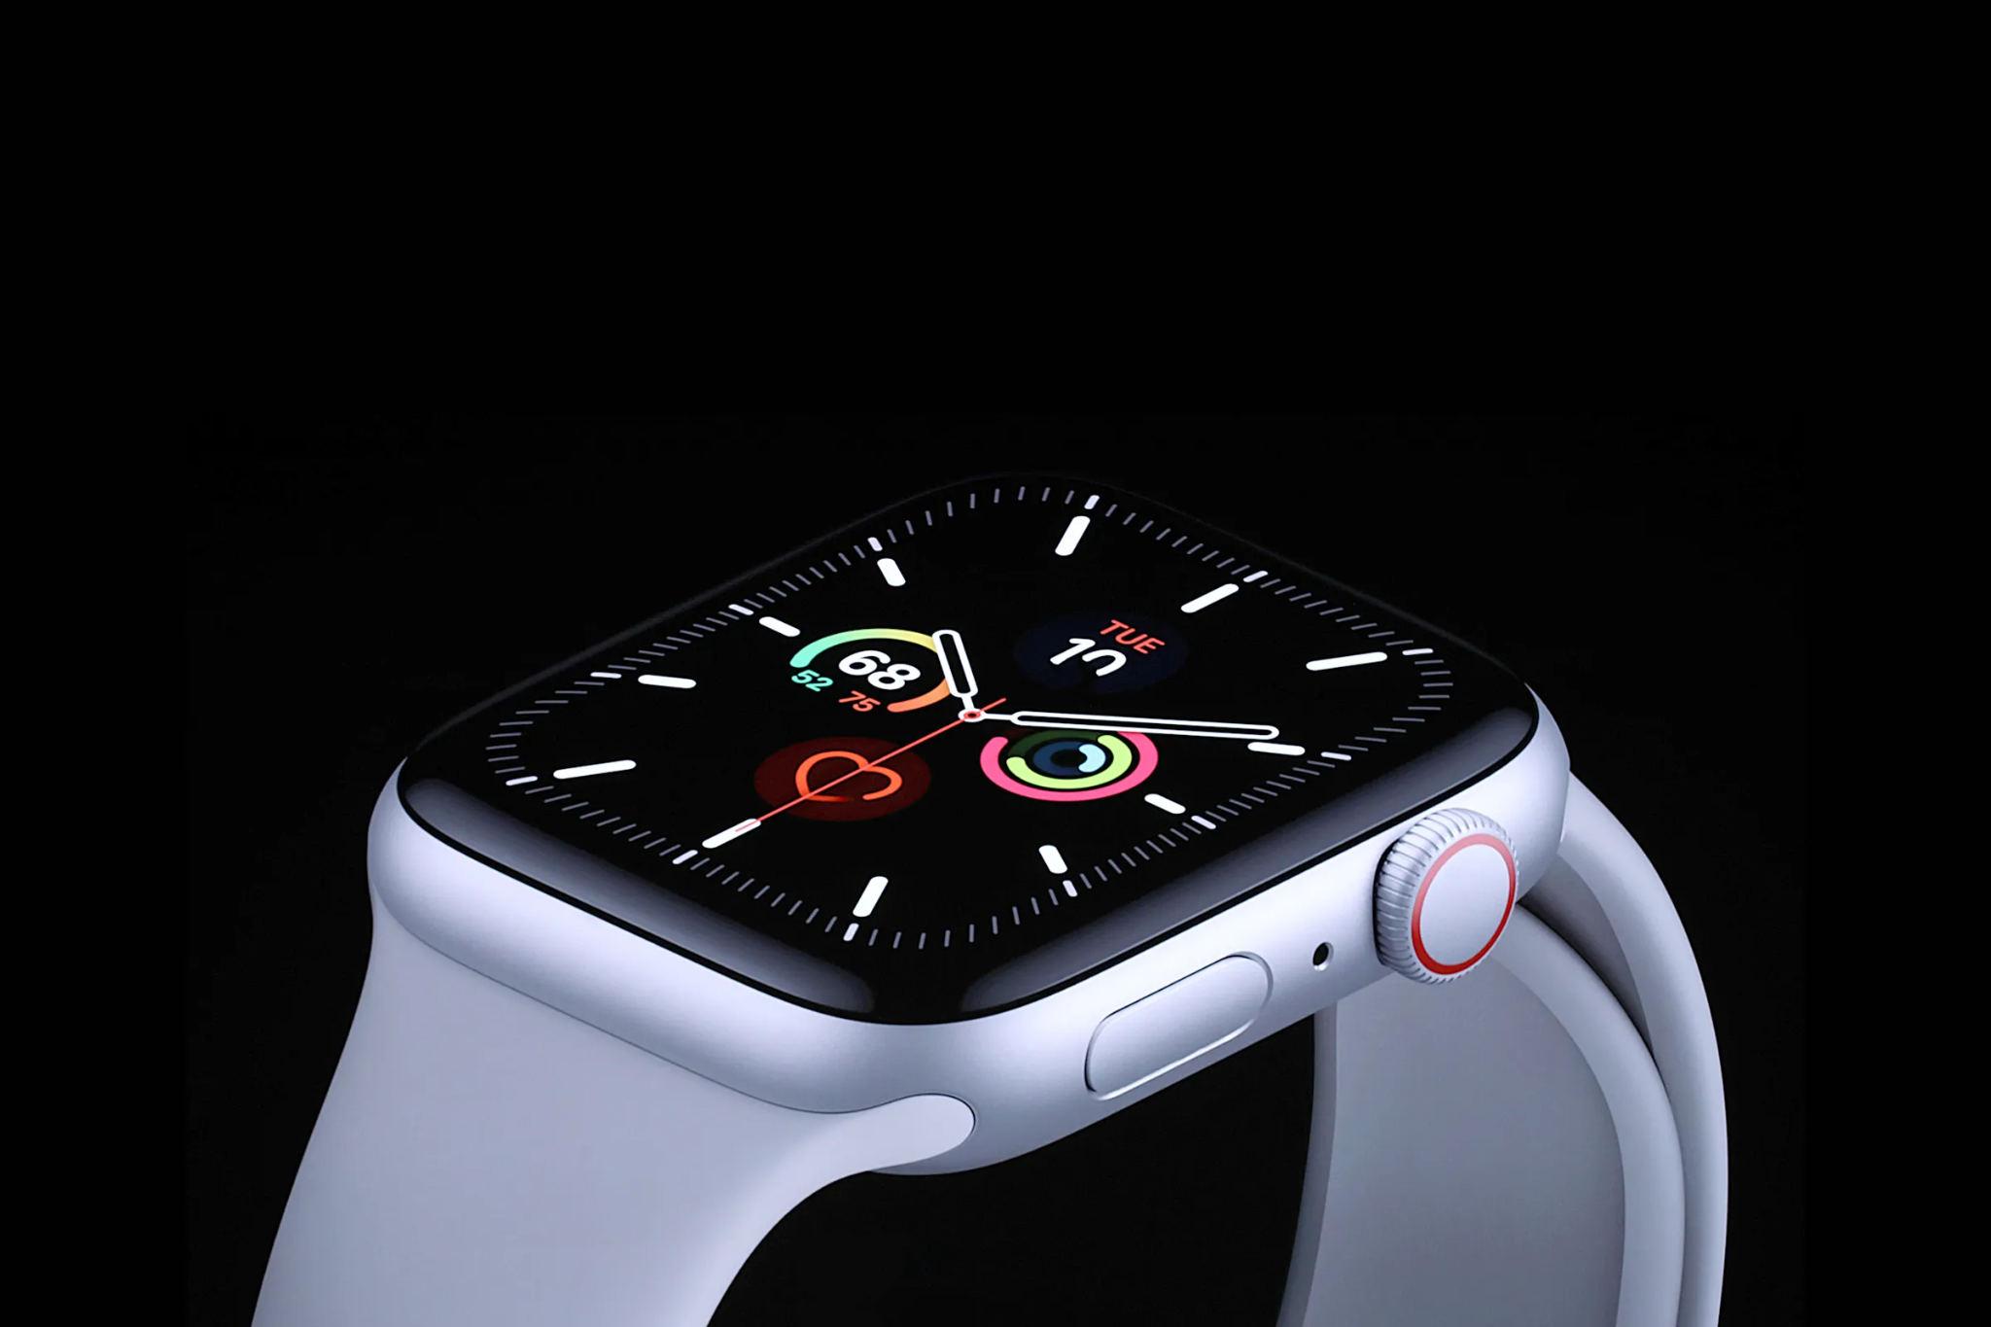

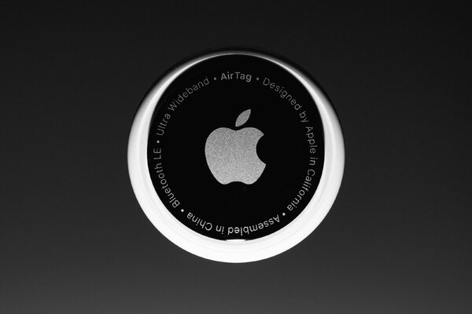


From consuming to generating data
Web1.0: Consumers
Web2.0: Creators
Sensors

Slide 3
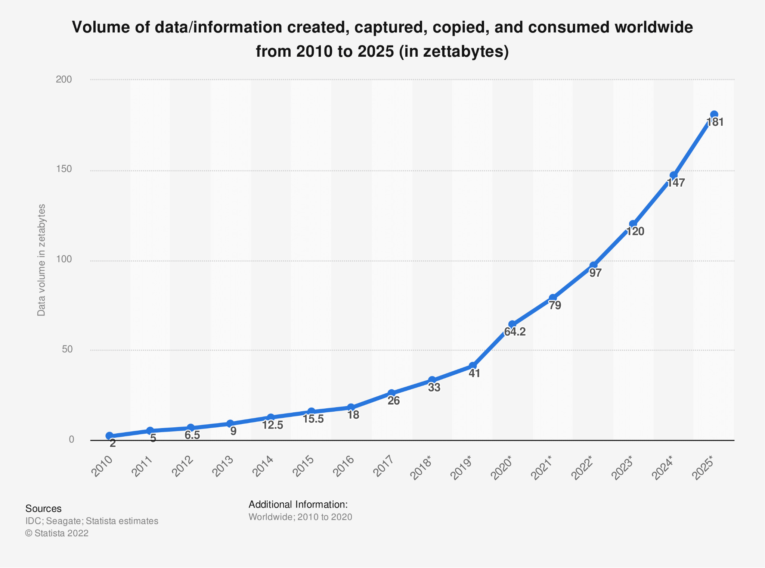
Data volumes are quickly growing
1 zettabyte (ZB) = 1 trillion GB

Slide 4
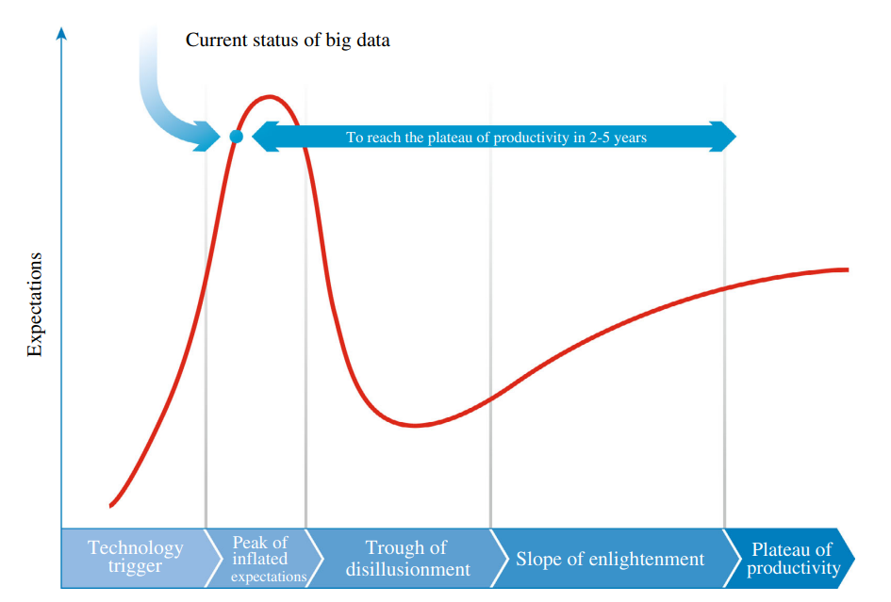
Big data has gone through the hype cycle
Guo et al., 2014

Slide 5
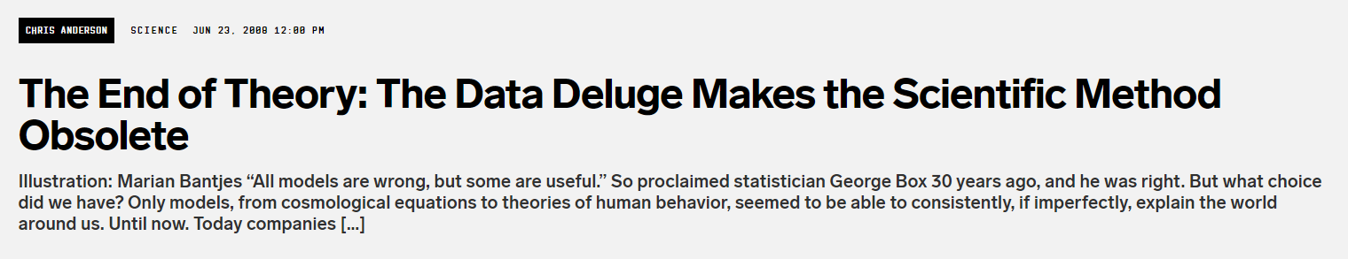
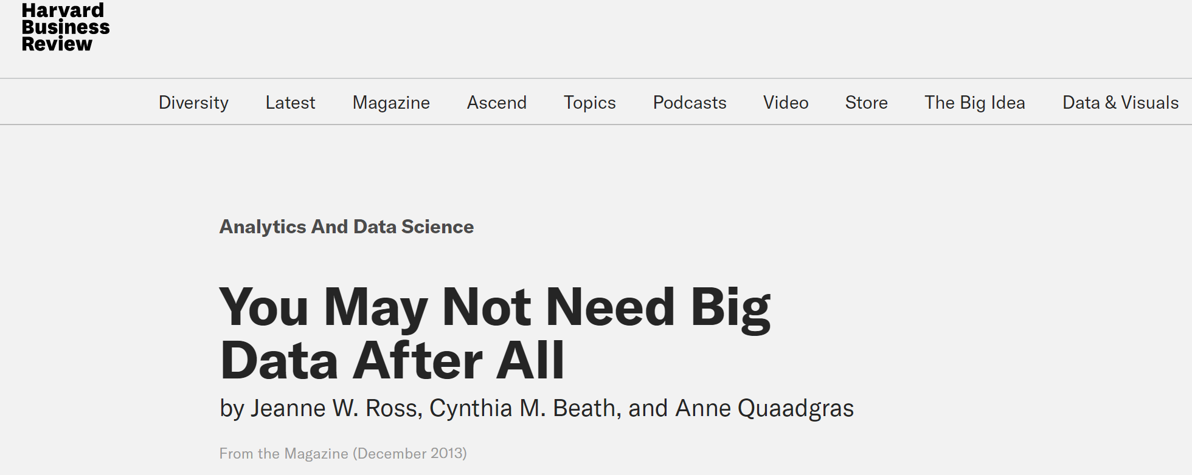
The hype is not always met

Slide 6
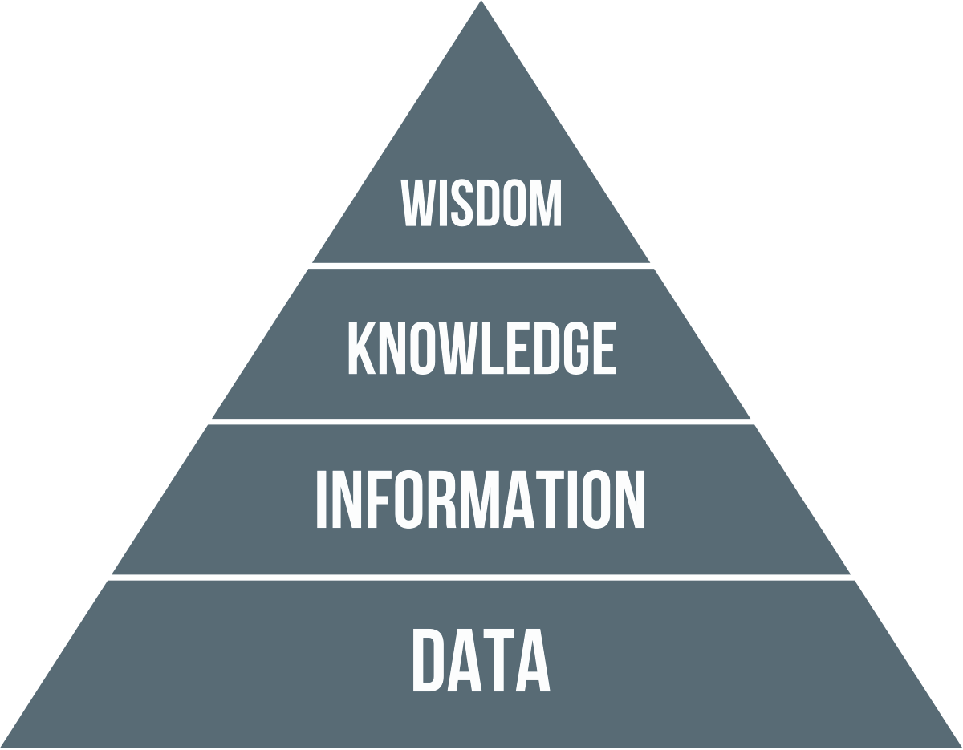
Achieving wisdom from data is a process

Slide 7
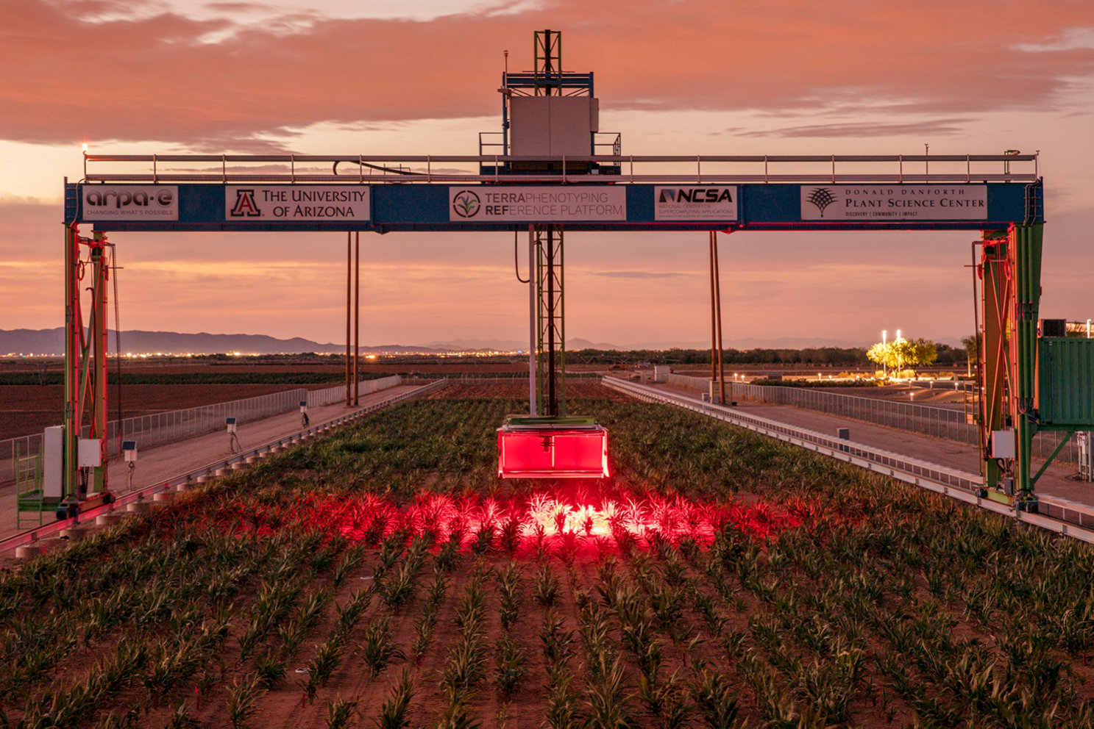
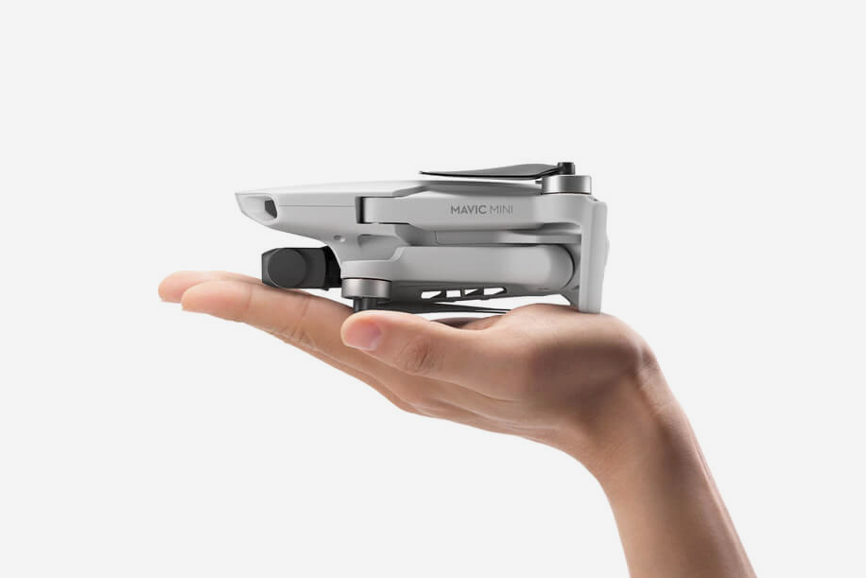
Big data applications in science
27,220,000 grams
249 grams

Slide 8
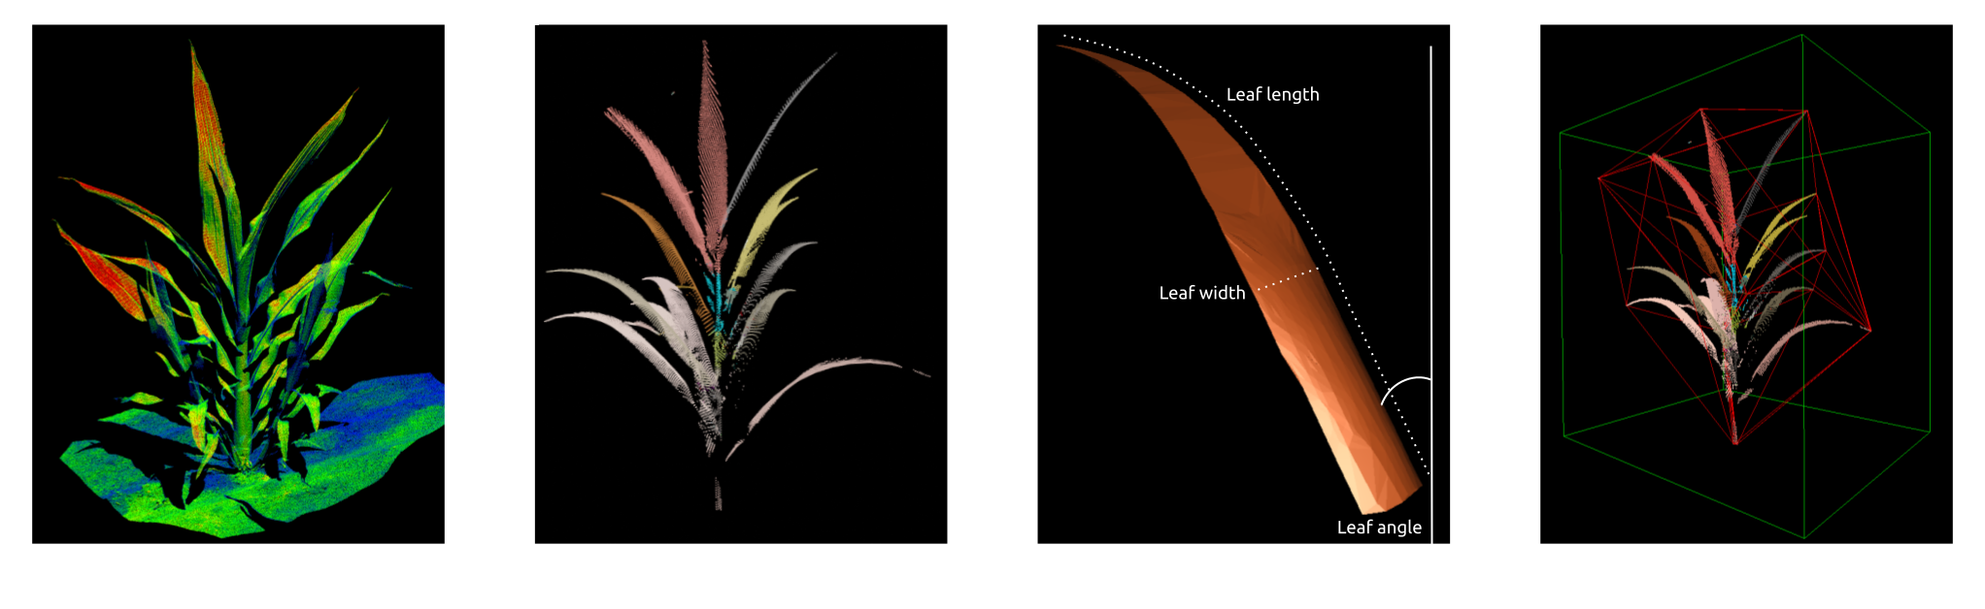
Extracting knowledge from big data

Slide 9
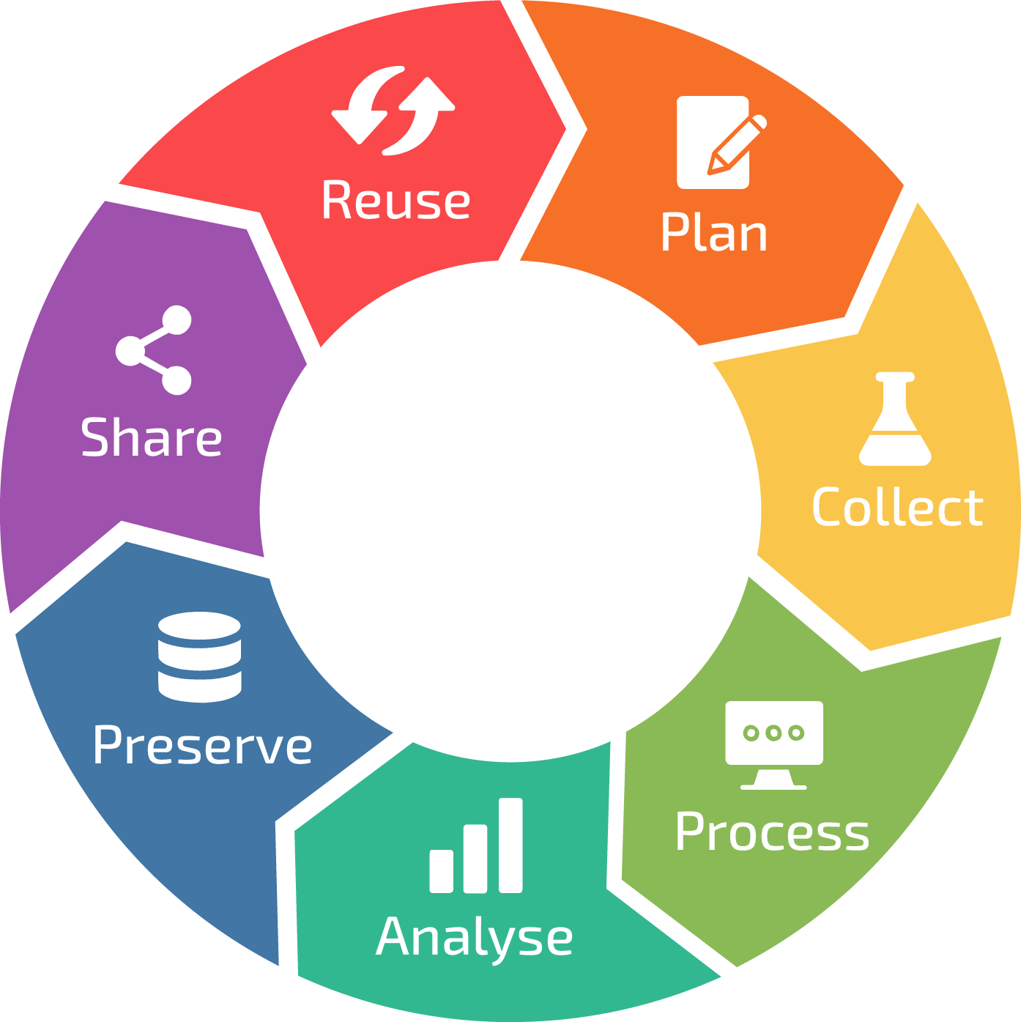
Managing data is a cycle

Slide 10
Managing data is a cycle

Slide 11




Building your computational toolkit
Session 1:
Python and Jupyter notebooks
Session 2:
Shell scripts, data analysis, and machine learning
Session 3:
Version control using GitHub

Slide 12
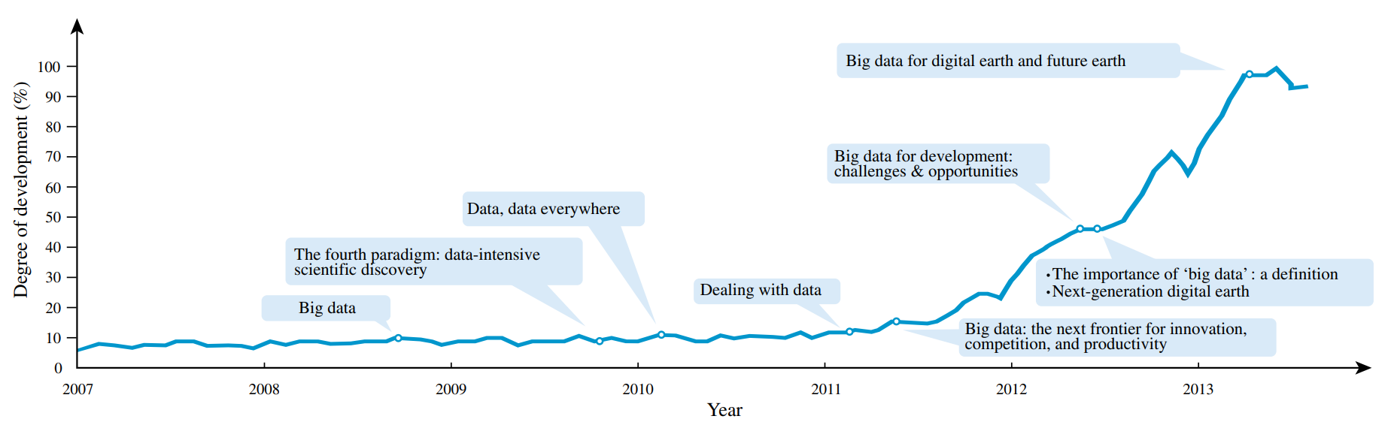
Data volumes are quickly growing

